Slide 1
INCOME EVALUATION

Slide 2
INTRODUCTION
Income evaluation is the process of assessing an individual’s or household’s financial resources to determine their total income, sources, and sufficiency. This analysis often involves considering factors like education, occupation, demographics, and government programs to provide a comprehensive picture of income dynamics.

Slide 3
ANALYSING AND FILTERING OF DATA
ANALYSING:
Income is based on different sectors/workclass.
Sectors are compared with occupation
Occupation lo how much income is getting profit and loss.
Income is compared with ages
Ages are divided >50 and <=50 and compared with sex and marital-status
Martial status based on education and num of hours work.
FILTERING:
Removing all the null values.
Applying fill up and down function on specific columns
Applying reverse row function and modified data on specific rows

Slide 4
DAX FUNCTIONS
sum_of_capital-gain = SUM(income_evaluation[ capital-gain])
sum_of_capital-loss = SUM(income_evaluation[ capital-loss])
count_of_income = COUNT(income_evaluation[ income])
avg_capital-gain = AVERAGE(income_evaluation[ capital-gain])
avg_capital-loss = AVERAGE(income_evaluation[ capital-loss])

Slide 5
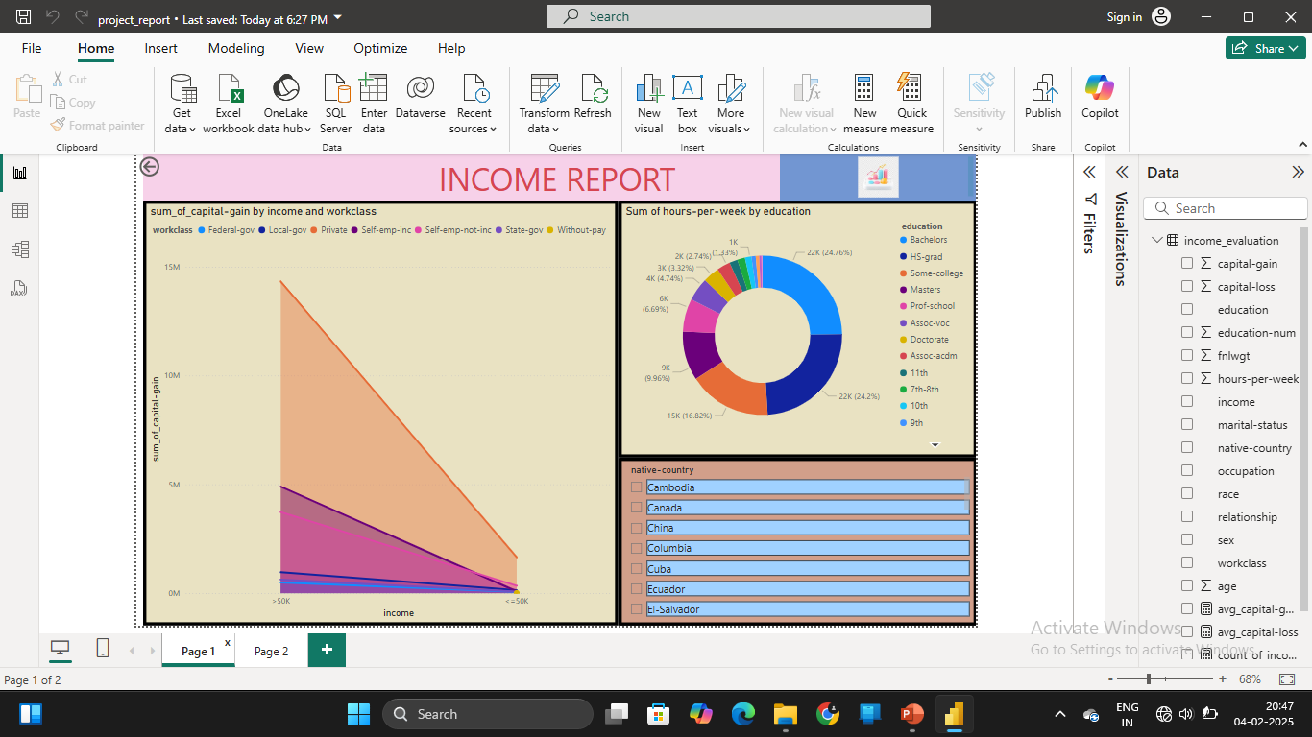
GRAPHICAL VISUALIZATION

Slide 6
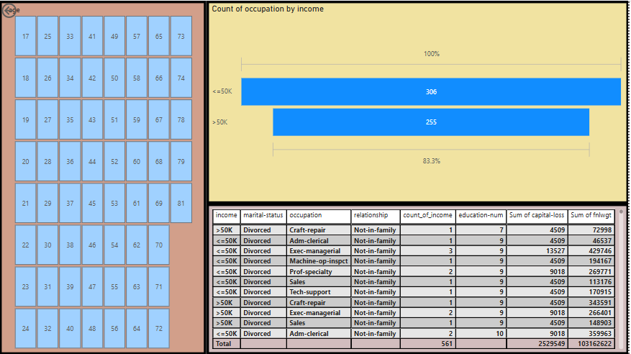

Slide 7
VISUALIZATION EXPLAINATION
Analyzes how capital gains impact on income across different work classes.
How many hours our work per week by education.
Identifying which occupation has tend on higher and lower income.
Suppose we represent gender on particular country what is their highest income and lowest income.
The age is compared with particular sector what is their income gain and loss on different country.
tables shows the data with particular columns based on income.

Slide 8
CONCLUSION
I conclude that capital gains significantly impact income, varying across work classes, education levels, and occupations. Longer working hours and higher education levels correspond to higher incomes. Certain occupations, like software engineering and medicine, tend to earn more. Additionally, income differs by country and age, with older adults in developed countries earning higher incomes.
I learned how to write dax functions on different numerical data.

Slide 9
THANK YOU

